Slide 1
H-2A Temporary Agricultural Visa Program 2024 Worker Protection Final Rule Briefing Key Changes to Forms ETA-790/790A and 9142A
Office of Foreign Labor Certification
Employment and Training Administration
United States Department of Labor
For Government Training Use Only
1

Slide 2
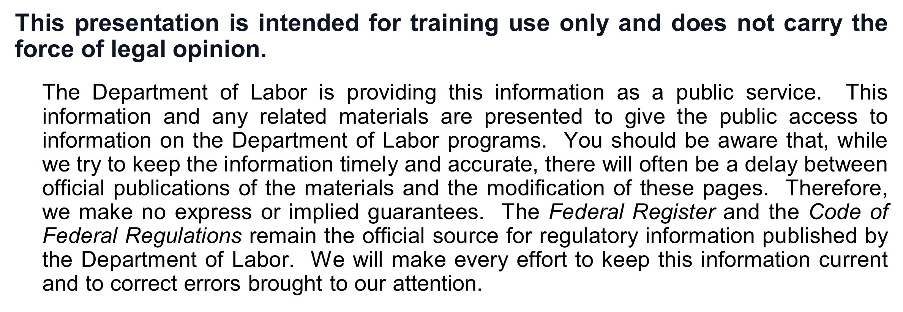
DISCLAIMER
For Government Training Use Only
2

Slide 3
Department of Labor 2024 H-2A Worker Protection Final Rule - Agenda
Implementation Timeline and Transition Procedures
Key Changes to Application Forms
ETA-790A, H-2A Agricultural Clearance Order
Addendum A – Additional Crop/Agricultural Activities and Wage Offers
Addendum B – Agricultural Business, Worksite, and Housing
Addendum C – Additional Material Terms and Conditions of the Job
ETA-9142A, H-2A Application for Temporary Employment Certification
Appendix C – Owners/Operators/Supervisors/Managers
Appendix D – Foreign Labor Recruiter Information
Upcoming FLAG System Webinar – August 21st
For Government Training Use Only
3

Slide 4
Department of Labor Implementation Timeline and Transition Procedures
August 29, 2024: Implementation date for OMB-approved revisions to the Forms ETA-790/790A and 9142A.
DOL will begin collecting information using the new forms and enforcing new rule provisions related to the contents of job offers (20 CFR 655.122), the employer’s assurances and obligations at 20 CFR 655.135, and provisions requiring the employer provide additional information at the time of filing (e.g., 20 CFR 655.130(a) and 655.137(b)).
Current Rule Processing: H-2A applications filed before 7:00 P.M. Eastern Daylight Time (EDT) on August 28 will be processed in accordance with the current regulations.
New Rule Processing: H-2A applications filed on or after 12:00 A.M. EDT on August 29 will be processed in accordance with the new final rule.
For Government Training Use Only
4

Slide 5
Department of Labor Implementation Timeline and Transition Procedures
YOU MUST link current SWA processed Job Orders (new Form ETA-790/790A) in the FLAG System to the H-2A application (new Form ETA-9142A) in order to submit on and after August 29.
All Job Orders that are not connected to a Form ETA-9142A under the current regulations AND SUBMITTED in the FLAG system by 7:00 P.M. EDT on August 28 will be removed from the filer’s external account and no longer accessible.
The SWA has 7 calendar days (20 CFR 655.121(e)(2)) to review the H-2A Job Orders. FLAG does allow for a Job Order to be linked to an ETA-9142A and submitted as an H-2A Application if the SWA makes no decision action in FLAG on the 8th calendar day.
Based on the August 29 transition date, 8 calendar days prior to August 28th is August 20th.
The start date 75 days from August 20th is November 3rd.
The start date 75 days from August 28th is November 11th.
For Government Training Use Only
5

Slide 6
Department of Labor Implementation Timeline and Transition Procedures
Major Changes to FLAG System User Account Profiles
New Foreign Labor Recruiter Profile (for use on Form ETA-9142A, Appendix D).
Modified Crop/Commodity Profile (for use on Form ETA-790A, Addendum A) where the Crop ID is removed, added a “Work State” field, and increased character limit to disclose piece rate units, estimated hourly, rates, and other special pay information.
Removed Agricultural Business Profile (due to changes on Form ETA-790A, Addendum B).
Modified Material Terms of Employment Profile (for use on Form ETA-790A, Addendum C).
Increased character limit from 3,500 to 5,000 characters.
Limited the drop-down options for the Section Number and Names (e.g., A.8g – Overtime Pay) to align with the applicable form sections.
Except for “Other Material Terms and Conditions,” the FLAG system will only permit one (1) Addendum C entry per form section to be imported on and after August 29.
For Government Training Use Only
6

Slide 7
Department of Labor Form ETA-790A, Agricultural Clearance Order
MAJOR FORM PREPARATION REMINDERS AND TIPS
Employers and authorized preparers MUST READ the OMB-approved general instructions carefully before completing the Forms ETA-790/790A (Job Order) and 9142A (H-2A Application).
Employer contact information (including email address) must be an employee of the employer and NOT the authorized attorney or agent unless that person is an employee of the employer.
A place of business must be a physical location – NOT a Post Office (P.O.) Box. A P.O. Box is a mailing address and not a valid physical address location.
Entering “See Addendum C” in any open text box area will result in a Notice of Deficiency requiring the employer to submit a modified job order or application to begin a response in the space provided on the form.
DO NOT repeat assurances or guarantees that are already covered by Section G.
For Government Training Use Only
7

Slide 8
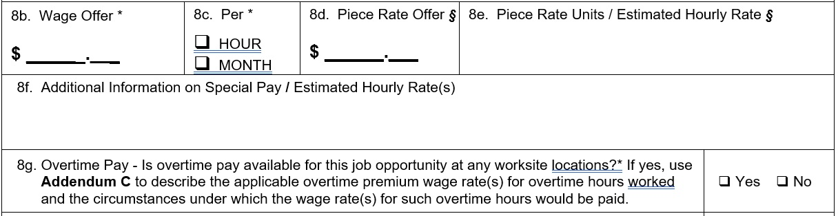
Department of Labor Form ETA-790A, Section A
NEW Field 8.f
For disclosure of special pay information (e.g., bonuses or other incentives) or the upper end of a wage range offered for a crop or activity and the estimated hourly equivalent.
Include or be prepared to make the method of calculating the estimated hourly wage rate equivalent(s) and supporting materials available to the SWA.
NEW Field 8.g
If “Yes,” use Addendum C to disclose the wage rate(s) to be paid; the circumstances under which the wage rate(s) for overtime hours will be paid; whether overtime wage rates will vary between places of employment; and citation to the applicable federal, State, or local law requiring overtime pay.
For Government Training Use Only
8
Notes:
8f i.e. bonuses

Slide 9
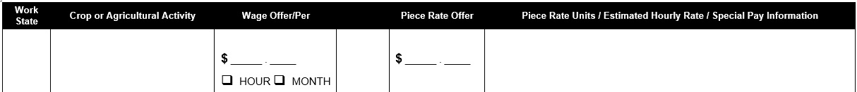
Department of Labor Form ETA-790/790A, Section A and Addendum A
Modified Field A.9 instructing the employer to complete Addendum A if the employer is offering additional rates not identified in Items 8.b. through 8.g. (e.g., multiple piece rates for multiple agricultural activities).
Modified Addendum A: Combined the “wage offer” and “per” columns and the added a new column to identify the work state.
For Government Training Use Only
9

Slide 10
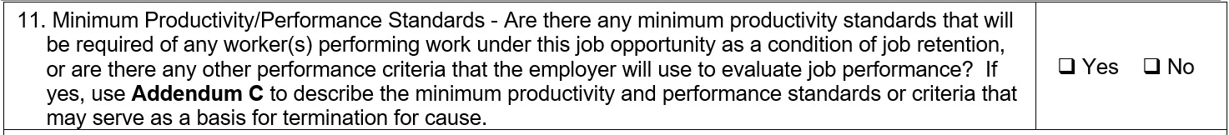
Department of Labor Form ETA-790/790A, Section A
NEW Field A.11 instructs the employer to complete Addendum C if the employer will have any performance expectations and/or minimum productivity standards that will be imposed on workers as a condition of job retention.
Disclose all qualitative and quantitative criteria for performance evaluation.
Employers are NOT required to disclose all policies, rules and procedures (i.e., work/housing rules).
Employers may include whatever policies, rules and procedures it deems appropriate, provided they (1) do not conflict with applicable law or regulation, AND (2) there is a clear reference to an Employee Handbook or other document the employer will provide to the workers with the job order.
For Government Training Use Only
10
Notes:
Any productivity standard would be weighed against any prevailing practice. If they already filed with a certain productivity standard, they can’t increase it (20 CFR 655.122(i)). Any termination for cause must comply with 20 CFR 655.122(n).

Slide 11
Department of Labor Form ETA-790/790A, Section A
Filing Tips for Field A.11
Each productivity standard must be static (i.e., cannot change during the work contract period), quantifiable, and that specifically quantify the expected output per worker in the specific crop or agricultural activity.
Productivity standards must be no more than those required by the employer in 1977, unless the OFLC Administrator approves a higher minimum, or, if the employer first applied for temporary agricultural labor certification after 1977 (see 20 CFR 655.122(l)(3)).
Examples of Unacceptable Performance Standard Statements:
Worker must “perform work in a timely and proficient manner” … “perform work at a sustained, vigorous pace” … “keep up with the crew” … “not work slower than other workers”
Important Reminder: The SWA or OFLC may, at their discretion, request documentation from the employer to substantiate the appropriateness of any job qualification (including productivity standards).
For Government Training Use Only
11
Notes:
Any productivity standard would be weighed against any prevailing practice. If they already filed with a certain productivity standard, they can’t increase it (20 CFR 655.122(i)). Any termination for cause must comply with 20 CFR 655.122(n).

Slide 12
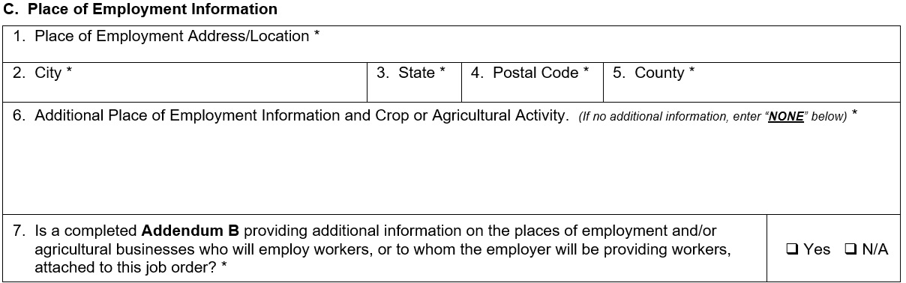
Department of Labor Form ETA-790/790A, Addendum B – C
Specified work location and crop or agricultural activity
For Government Training Use Only
12

Slide 13
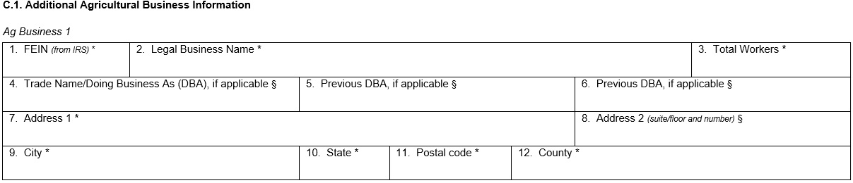
Department of Labor Form ETA-790/790A, Addendum B – C.1
Use Section C.1 for any Ag Business that will employ workers or to which the employer will provide the workers attached to the job order.
For Government Training Use Only
13

Slide 14
Department of Labor Form ETA-790/790A, Addendum B – C.1
Individual Employers: Do not complete Section C.1.
Individual Employers filing as an H-2ALC: Must complete a Section C.1 entry for each fixed site employer client and the number of workers entered for each entry can match the total number of workers entered on Form ETA-790A, Section A, Item A.2a.
Itinerate Employers (Custom Combine, Sheep Shearing & Bee Keeping): Must complete a Section C.1. entry for each employer being provided a service and the number of workers entered for each entry can match the total number of workers entered on Form ETA-790A, Section A, Item A.2a.
24/7 Livestock Herders: Do not complete Section C.1 unless the employer is filing as an H-2ALC or has a joint employer agreement with additional employer(s).
For Government Training Use Only
14

Slide 15
Department of Labor Form ETA-790/790A, Addendum B – C.1
Joint Employers: Complete Section C.1 for each additional agricultural employer sharing employment of the workers and the number of workers entered for each entry can match the total number of workers entered on Form ETA-790A, Section A, Item A.2a.or have zero "0" entered.
Association - Joint Employers: Must complete a Section C.1. entry for each of the Employer members of the Association, agreeing to employ workers for the specific job order.
Addendum B, Section C.1. data will be used in FLAG to generate the Employer details section (Pg 2) of the invoice for Association Joint Employers. Each C.1. entry will serve as the Employer’s itemized invoice bill line by using the Legal Business Name entered in item 2 and then the Total Workers number entered in Item 3.
An entry of zero (0) for number of workers is allowed if the association member has joint agreements with other members.
For Government Training Use Only
15

Slide 16
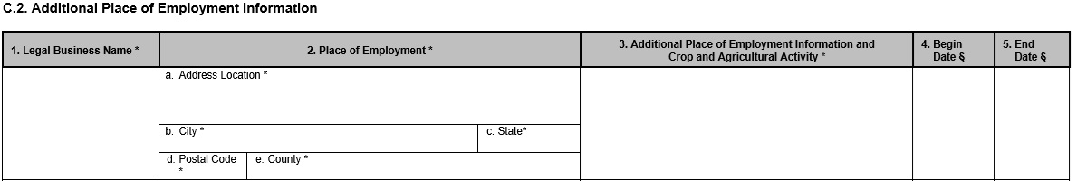
Department of Labor Form ETA-790/790A, Addendum B – C.2
Use Section C.2 to list any additional place of employment locations
For Government Training Use Only
16

Slide 17
Department of Labor Form ETA-790/790A, Addendum B – C.2
Individual Employers: Complete Section C.2 when the employer has multiple work locations where work will be performed. Estimated start and end dates are not required to be entered for each additional work location.
Individual Employers filing as an H-2ALC: Complete a Section C.2 entry for each unique work location not listed on Form ETA-790A, Section C. Estimated start and end dates are not required to be entered for each additional work location.
Itinerant Employers (Custom Combine, Sheep Shearing & Bee Keeping): Complete a Section C.2 entry for each unique work location not listed on Form ETA-790A, Section C. Estimated start and end dates are required to be entered for each work location.
For Government Training Use Only
17

Slide 18
Department of Labor Form ETA-790/790A, Addendum B – C.2
24/7 Livestock Herders: Complete a Section C.2 entry for each unique county location. Only the county and state are required for Item 2, place of employment. In item 3, for additional place of employment information include the owner(s) of the land being grazed. Estimated start and end dates are required to be entered for each work location.
Joint Employers: Complete a Section C.2 entry for each unique work location not listed on Form ETA-790A, Section C. Estimated start and end dates are not required to be entered for each work location.
Association - Joint Employers: Complete a Section C.2 entry for each unique work location not listed on Form ETA-790A, Section C. Estimated start and end dates are required to be entered for each work location.
For Government Training Use Only
18

Slide 19
Department of Labor Form ETA-790/790A, Addendum B – C.2
Item 3 – Crop and Agricultural Activity: This information is a new requirement for each additional work location.
FLAG will provide a standard statement to be inserted if the same activities as described in the job description details will be performed.
If an Addendum A was created, FLAG will provide a dropdown menu option of internally generated crop IDs that can be selected for a specific worksite.
For Government Training Use Only
19

Slide 20
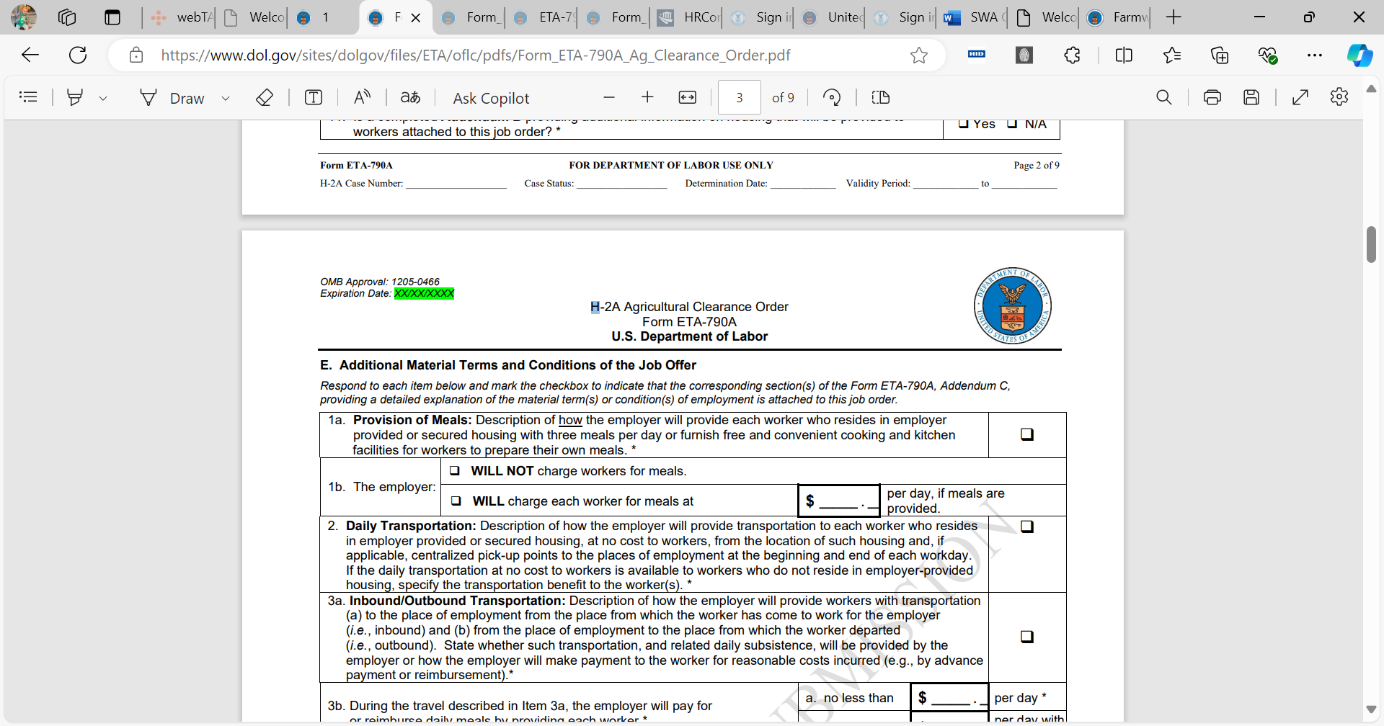


Department of Labor Form ETA-790/790A, Section E
Section E is now a list of five (5) material terms and conditions that will require the completion of only one (1) Addendum C.
For Government Training Use Only
20

Slide 21
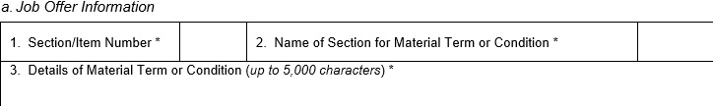
Department of Labor Form ETA-790/790A, Addendum C
The Addendum C contains a large free text area, and the space has now increased from allowing 3,500 characters to 5,000. An Addendum C narrative is to be specific in describing details that pertain to a material term or condition on an ETA Form section/item.
For Government Training Use Only
21

Slide 22
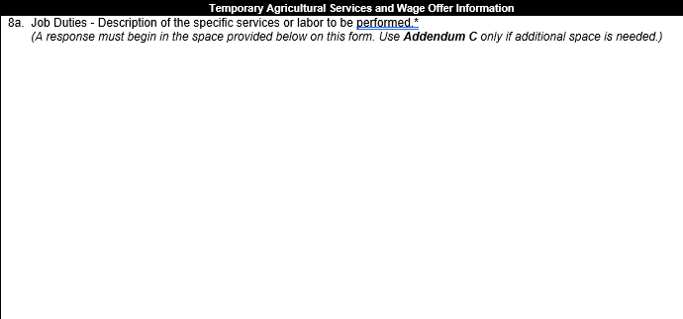

Department of Labor Form ETA-790/790A, Addendum C
Item A.8a - Job Duties & B.6 - Job Qualifications/Requirements require there to be written details on the ETA-790A form section. At least 80% of the allowable character limit must be utilized before an Addendum C can be created for the specific form item.
For Government Training Use Only
22

Slide 23
Department of Labor Form ETA-790/790A, Addendum C
The below Form ETA-790A items will allow for an Addendum C to be used to describe the material terms and conditions if they are applicable to the job opportunity.
Item A.8g - Overtime Pay
Item A.11 - Minimum Productivity/Performance Standards
Item E.4 - Deductions from Pay
Item E.5 - Other Material Terms and Conditions
For Government Training Use Only
23

Slide 24
Department of Labor Form ETA-790/790A, Addendum C
The below Form ETA-790A items require the employer to check a box in Section E for the specific item signaling that an Addendum C describing the material terms and conditions has been completed.
Item E.1a - Provision of Meals
Item E.2 - Daily Transportation
Item E.5 - Inbound/Outbound Transportation
For Government Training Use Only
24

Slide 25
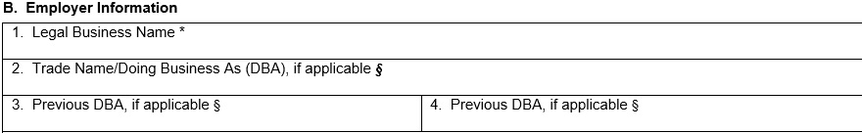
Department of Labor Form ETA-9142A, Section B
Section B: New request of Doing Business As (DBA) for prior three years.
New: Additional form items included to allow for including previous DBAs used in the prior two years.
For Government Training Use Only
25

Slide 26
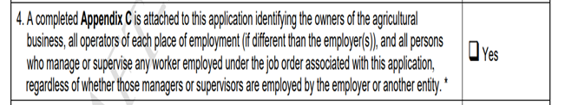
Department of Labor Form ETA-9142A, Section E
Mark “Yes” to indicate that the employer is submitting a completed Appendix C that provides the identity, location, and contact information for the owners of each employer of workers under the job order associated with this application, and the identity, location, and contact information for the operator(s) of each place of employment
For Government Training Use Only
26

Slide 27
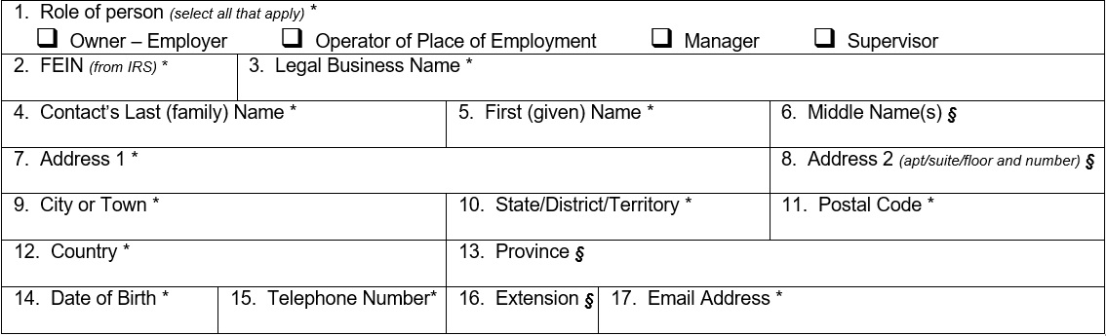
Department of Labor Form ETA-9142A, Appendix C
For Government Training Use Only
27

Slide 28
Department of Labor Form ETA-9142A, Appendix C
Pursuant to 20 CFR 655.130(a), the employer or joint employer (as applicable) must disclose to the Department the identity, location and contact information of all owners of each employer, the operators of each place of employment (if different than the employer(s)), and all managers and supervisors of workers employed under the job order associated with this application, regardless whether those managers or supervisors are employed by the employer(s) or another entity.
Important Note: Each employer, any joint employer, and each operator of any place of employment identified on the job order (Form ETA-790/790A), must be identified in each section of “Additional Contact Information” on Appendix C.
Item 14: Enter the Date of Birth of the individual identified in this section. The Employer is reminded that it must exercise due diligence when gathering, disclosing and updating as necessary, this required information. If after a good faith effort to obtain this information, the Employer is unable to ascertain the Date of Birth at the time of filing, please enter 88/88/8888.
For Government Training Use Only
28

Slide 29
Department of Labor Form ETA-9142A, Appendix C
Owner: An owner legally owns or has a controlling operational role in the employer(s) business.
Any owner with ownership of more than 50 percent of a business, and
Any owner who exercises any decision-making responsibilities over the business.
The owner of the parent entity, if the employer is a branch, subsidiary, or affiliate of a corporate or joint venture.
Operator of place of employment: An operator runs the agricultural business, making day-to-day management decisions. An operator could be an owner, hired manager, cash tenant, share tenant, and/or a partner.
Manager: A person whose duties and responsibilities include formulating policies, managing daily operations, and planning the use of materials and human resources.
Supervisor: A person who supervises and coordinates the activities of agricultural, range, aquacultural, and related workers.
For Government Training Use Only
29

Slide 30
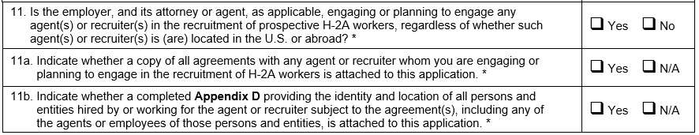
Department of Labor Form ETA-9142A, Section E
Foreign Labor Recruiter Information
Section facilitates disclosure of agreements with foreign labor recruiters and information about the foreign labor recruiters that have or will be engaged in the recruitment of H-2A workers.
“N/A” can be marked where the employer has NOT utilized and has no plans to use the services of a foreign labor recruiter in the recruitment of H-2A workers.
For Government Training Use Only
30

Slide 31
Department of Labor Form ETA-9142A, Section E
Foreign Labor Recruiter Information – Field E.11
Mark “Yes” if the employer has engaged or is planning to engage any agent(s) or foreign labor recruiter(s), directly or indirectly, in the recruitment of prospective H-2A workers, regardless of whether such agent(s) or recruiter(s) is (are) located in the U.S. or abroad.
Mark “No” here if the employer has not engaged and has no plans to engage any agent(s) or recruiter(s) in the recruitment of prospective H-2A workers.
Important Reminder: Employer must update this information with any changes during the contract period (§ 655.137(c)) and must retain this information for a period of three years (§ 655.167(c)(8)).
For Government Training Use Only
31

Slide 32
Department of Labor Form ETA-9142A, Section E
Foreign Labor Recruiter Information – Field E.11a
Mark “Yes” to indicate that the employer is submitting a copy of all contracts and agreements with any agent and/or recruiter whom the employer is engaging or planning to engage in the recruitment of H-2A workers for this application.
Mark “N/A” here if there are no agreements with any agent or recruiter whom the employer is engaging or planning to engage in the recruitment of H-2A workers.
Mark “N/A” if question E.11 above is marked “No.”
Important Reminder: An employer is required under 20 CFR 655.137(a) to submit a copy of all agreements with any agent or recruiter whom it engages or plans to engage in the recruitment of H-2A workers.
For Government Training Use Only
32

Slide 33
Department of Labor Form ETA-9142A, Section E
Foreign Labor Recruiter Information – Field E.11b
Mark “Yes” to indicate that the employer has provided, through Appendix D, the identity and location of all persons and entities hired by or working for the foreign labor recruiter or agent, and any of the agents or employees of those persons and entities, to recruit prospective foreign workers for the H-2A job opportunity.
If the employer has NOT utilized and has no plans to use the services of a foreign labor recruiter in the recruitment of H-2A workers for this application, mark “N/A” here.
Important Reminder: OFLC will publish a foreign labor recruiter registry containing a recruiter’s identifying information, as in H-2B. § 655.137(d).
For Government Training Use Only
33

Slide 34
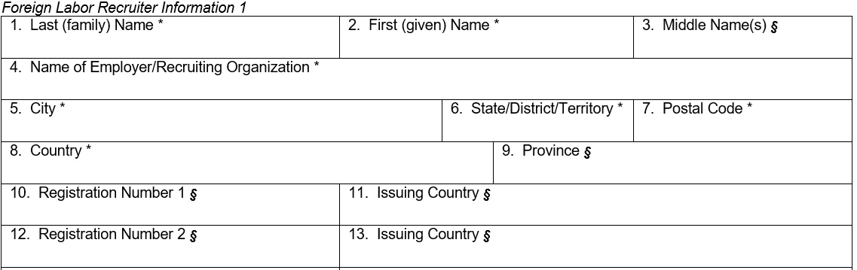
Department of Labor Form ETA-9142A, Appendix D
Important Reminders
Include the identity and location of all persons and entities hired by or working for the recruiter or agent, and any of the agents or employees of those persons and entities.
Each form collects U.S. and foreign locations.
Complete as many additional Appendix D form sections as are necessary to disclose all persons.
NEW Foreign Labor Registration Number Fields
Issued by a governmental agency with jurisdiction to authorize or license persons to provide recruiting services.
Enter all “9s” if the person is NOT registered or refuses to provide the registration OR “N/A” if not applicable.
For Government Training Use Only
34

Slide 35
Department of Labor Upcoming FLAG System Webinar
Upcoming H-2A Webinar
August 21, 2024
In collaboration with OFLC, staff representing the Department’s Office of the Chief Information Officer will provide a demonstration of the technical changes to the job order and application filing process in the FLAG System – which will be implemented on August 29.
For Government Training Use Only
35

